Slide 1
Analysis of SA Banking Industry
Presented by Smangaliso Zuma

Slide 2
Scope
Purpose of this presentation
Loans and deposits
Market share
Loan to deposit ratio
Mortgages
Investments
Conclusion

Slide 3
Purpose of this presentation
Conduct a Banking industry analysis with a focus on:
Loans and deposits
Market share
Loan to deposit ratio
Mortgages
Investments

Slide 4
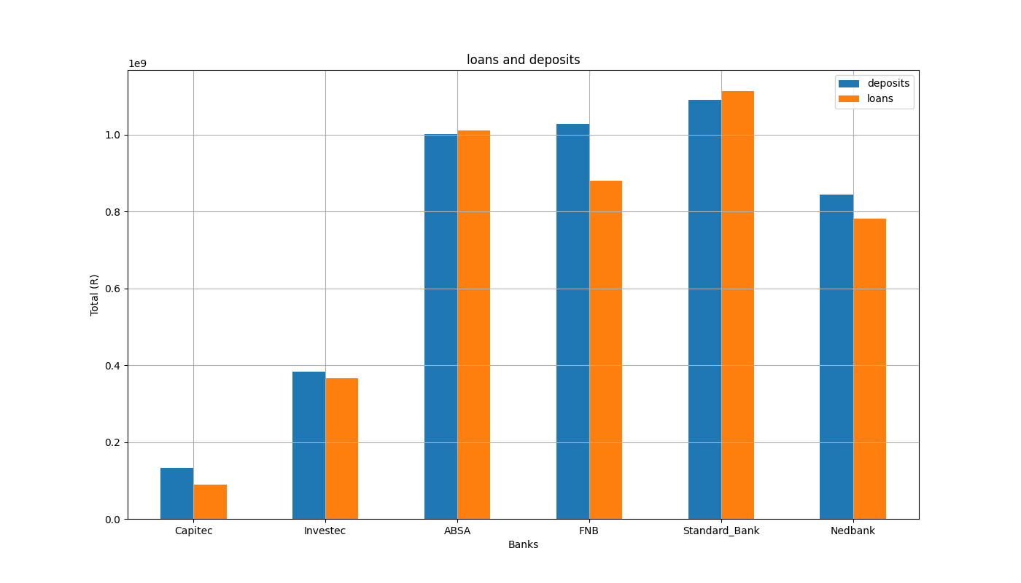
Loans and Deposits

Slide 5
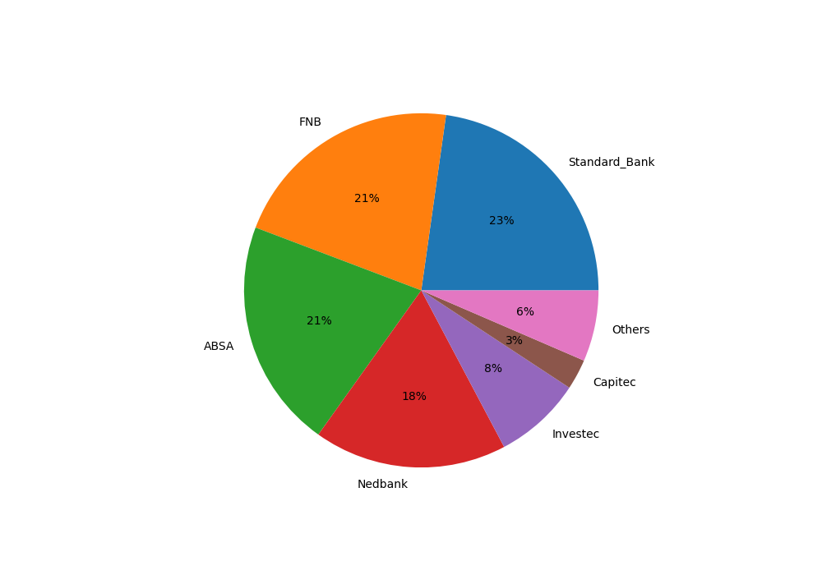
Market Share

Slide 6
Loan to deposit ratio

